Slide 1
Places to learn more:
Particle and nuclear physics links
http://pdg.lbl.gov
http://particleadventure.org
http://www.slac.stanford.edu/gen/edu/aboutslac.html
http://www.bnl.gov/bnlweb/sciindex.html
http://www.bnl.gov/rhic/
http://public.web.cern.ch/public/
http://www.fnal.gov/
http://www.er.doe.gov/production/henp/np/index.html
http://www.science.doe.gov/hep/index.shtm

Slide 2
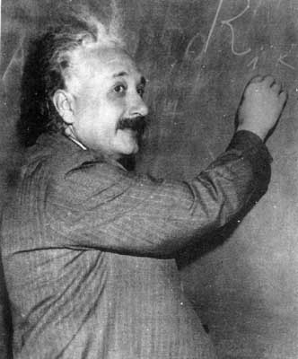
Inquiring minds want to know ...
Yo! What holds it together?

Slide 3
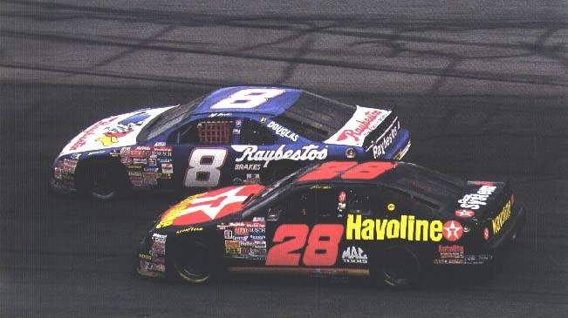
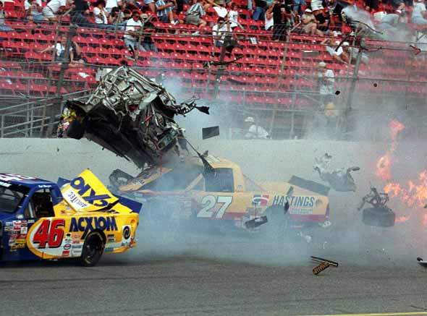
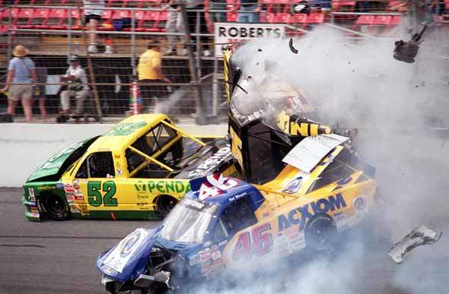

Slide 4
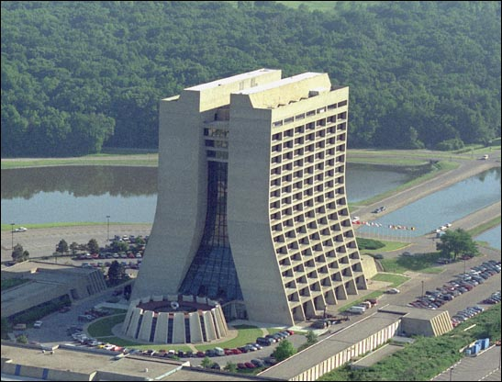
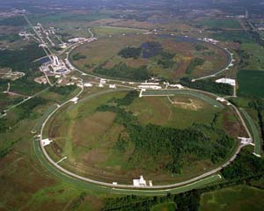
Fermi National Accelerator Laboratory (near Chicago)

Slide 5
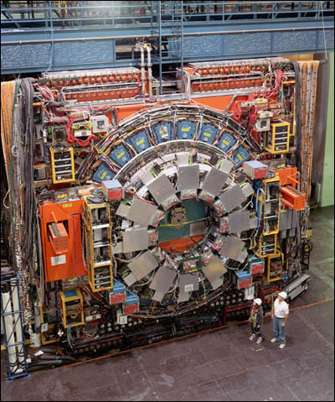
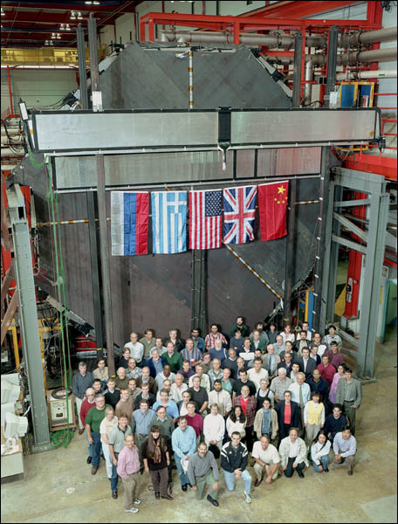
CDF
Minos

Slide 6
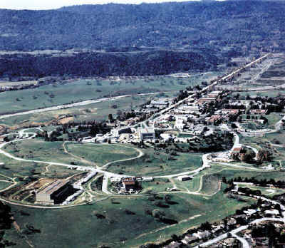
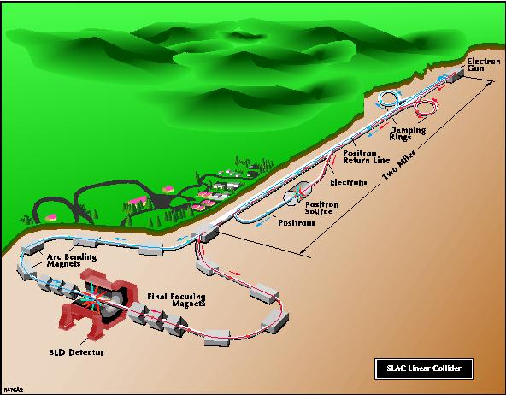
Stanford Linear Accelerator Center

Slide 7
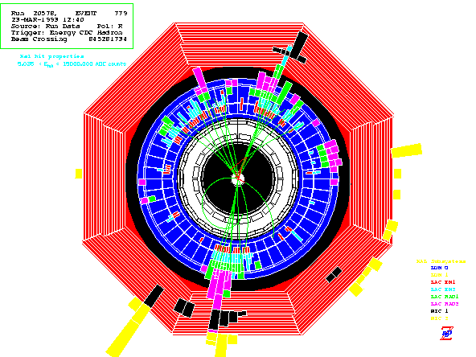
Event display from the SLD experiment at SLAC

Slide 8
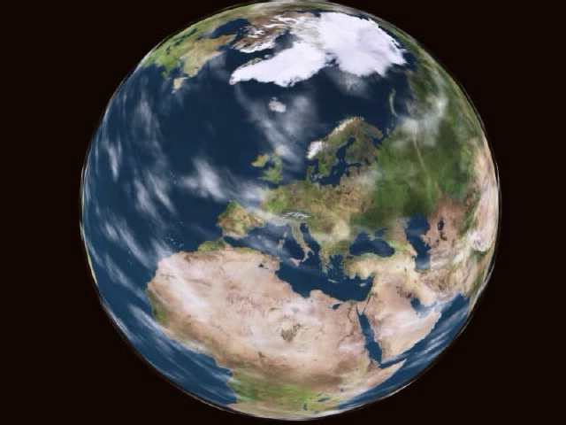

Slide 9
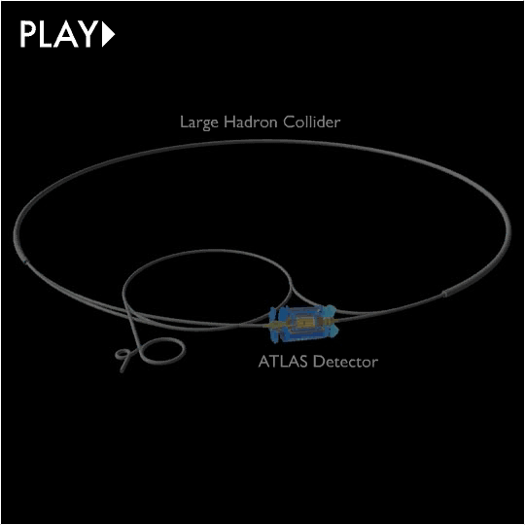

Slide 10
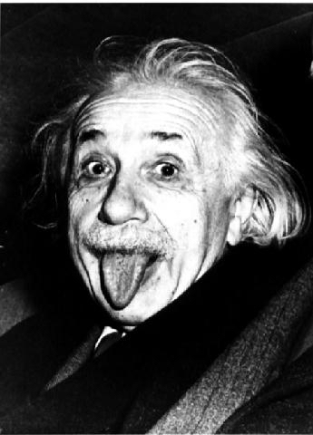
What forces exist in nature?
What is a force?
How do they interact?
How do forces change with energy or temperature?
How has the universe evolved?

Slide 11
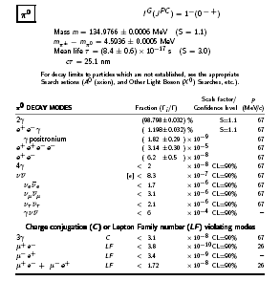
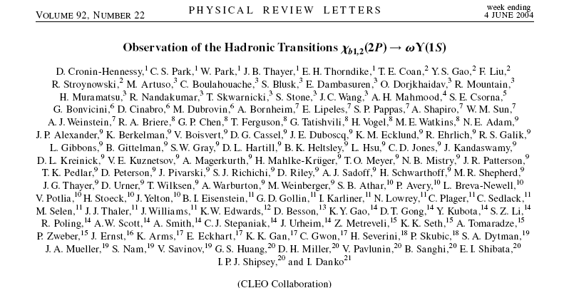
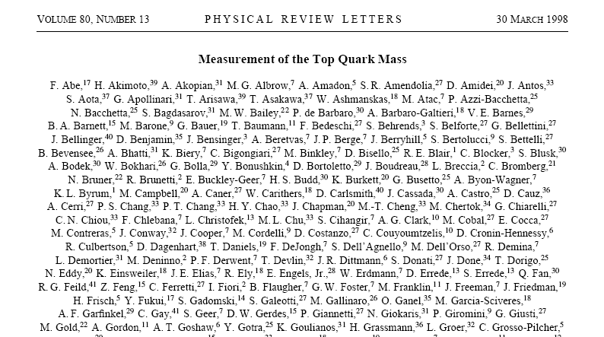
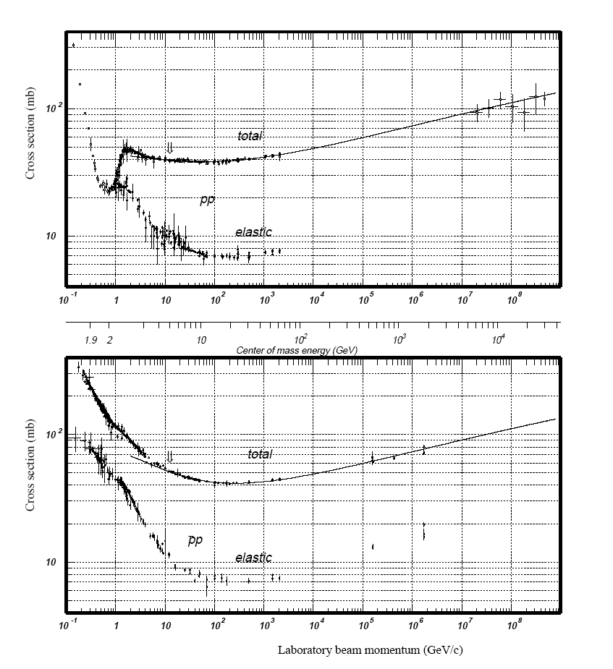
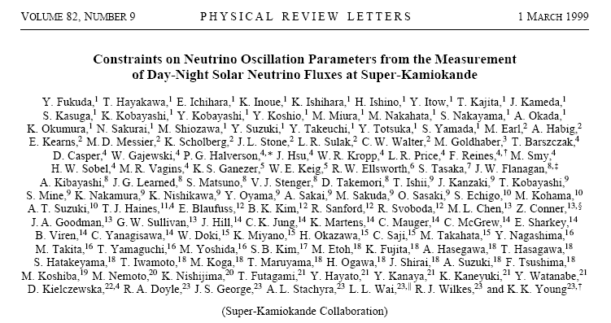
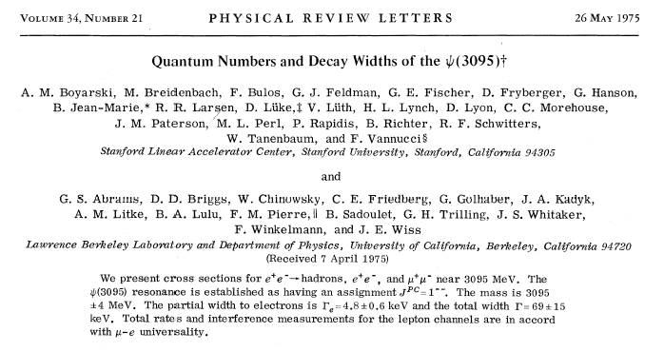

Slide 12
Mini-Ph.D. – Quantum Mechanics 101
Lesson 1:
Size actually does matter.

Slide 13
Determine the postion and velocity of a car … no problem

Slide 14
Determine the postion and velocity of a small particle … no problem

Slide 15
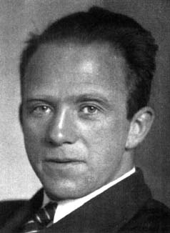
Problem!
Heisenberg uncertainty principle
Cannot have perfect knowledge of both the position and velocity
Heisenberg

Slide 16
The fundamental nature of forces: virtual particles
ΔEΔt ≈ h Heisenberg
E = mc² Einstein
e⁻
Dear Steve,
Party relatively hard!
-Al

Slide 17
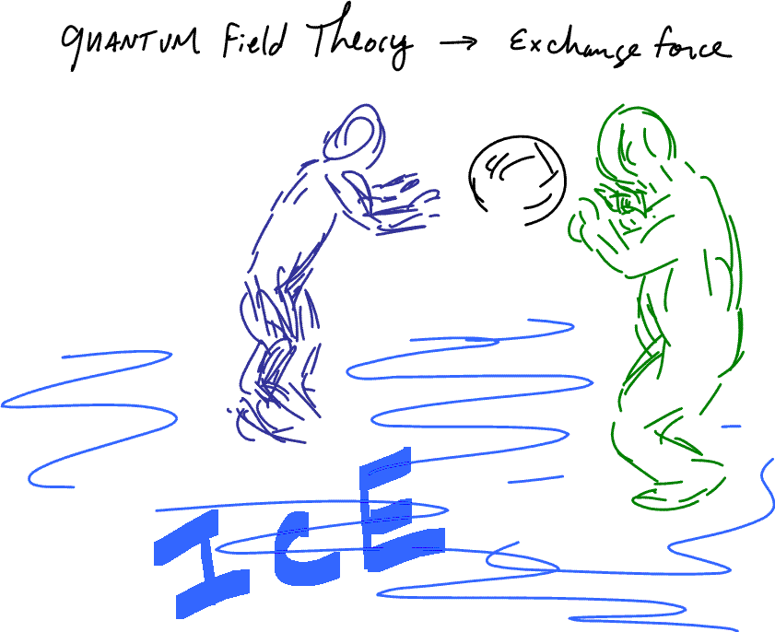

Slide 19
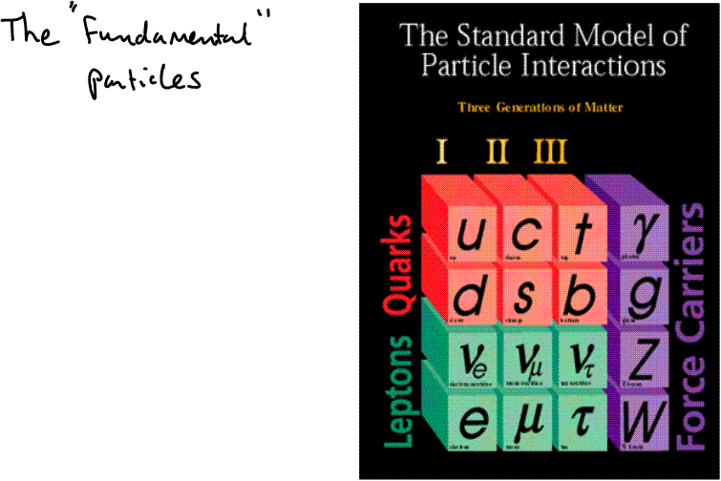

Slide 20
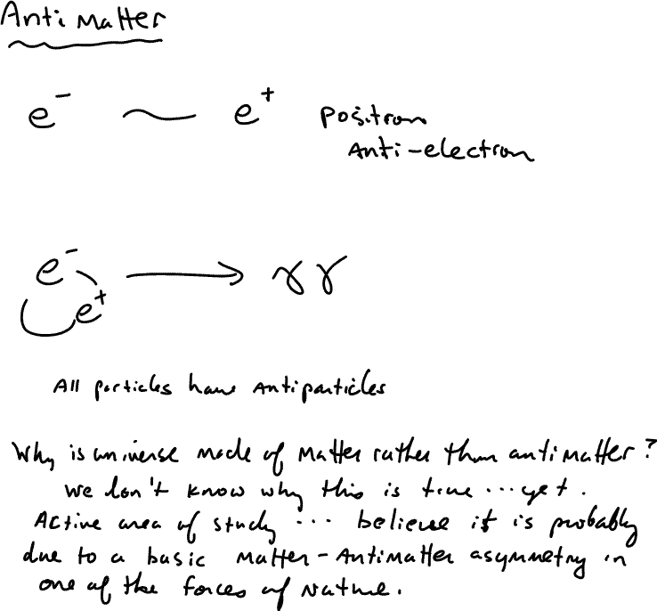

Slide 21
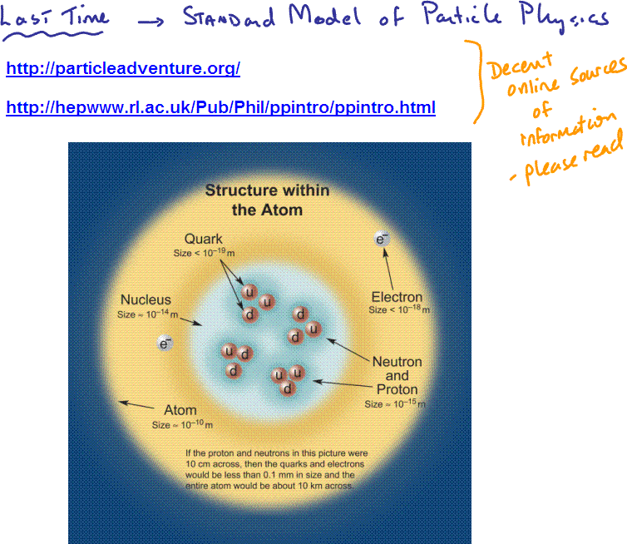

Slide 22
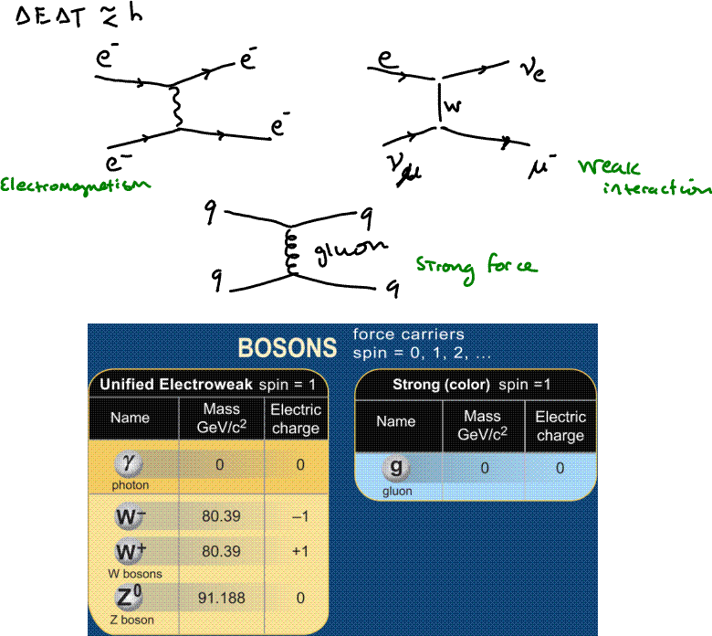

Slide 23
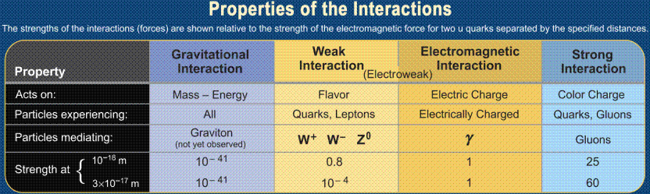

Slide 24
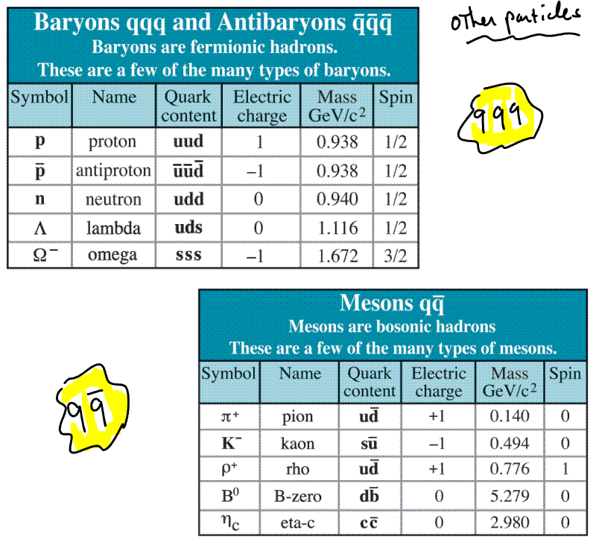

Slide 25

quarks
leptons
Gauge bosons
u c t
d s b
e μ τ
ν_{e} ν_{μ} ν_{τ}
e
W, Z, g, γ G
g
γ
Strong interaction
Hadrons
Baryons qqq
qq mesons
p = uud
n = udd
K = us or us
π = ud or ud
nuclei
atoms
Electromagnetic
interaction

Slide 26
Quantum Chromodynamics QCD
relative strength
Why bare quarks have never been observed.
asymptotic freedom
distance
energy density, temperature
quark-antiquark pair
created from vacuum
quark
Strong color field
Energy grows with separation !!!
“white” π⁰
(confined quarks)
“white” proton
(confined quarks)
E=mc² !
“white” proton
Thanks to Mike Lisa (OSU) for parts of this animation

Slide 27
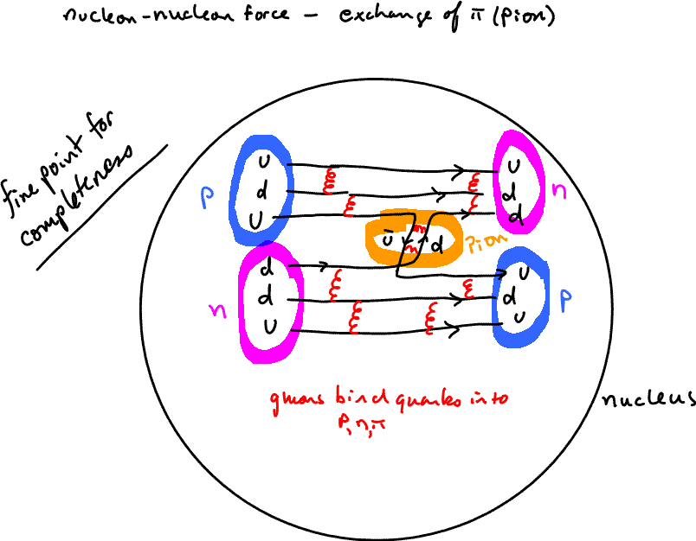

Slide 28
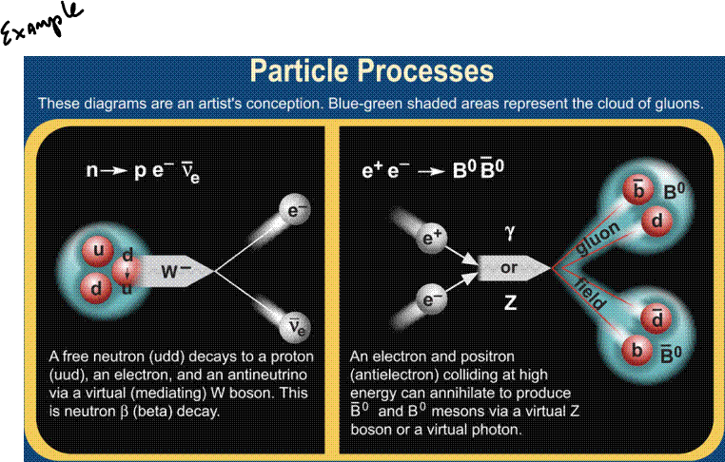

Slide 29
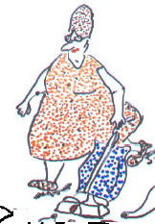
The Vacuum
qq
e⁺e⁻
e⁺e⁻
e⁺e⁻
e⁺e⁻
e⁺e⁻
qq
e⁺e⁻
qq
qq
-R. Kolb
Much ado about NOTHING:
Nothing is something
Nothing has energy
Nothing interacts with something
qq
qq
qq
qq
e⁺e⁻
qq
qq
qq
e⁺e⁻
e⁺e⁻
e⁺e⁻
e⁺e⁻
e⁺e⁻
e⁺e⁻
e⁺e⁻
qq
qq
e⁺e⁻
qq
qq
qq
qq

